Slide 1

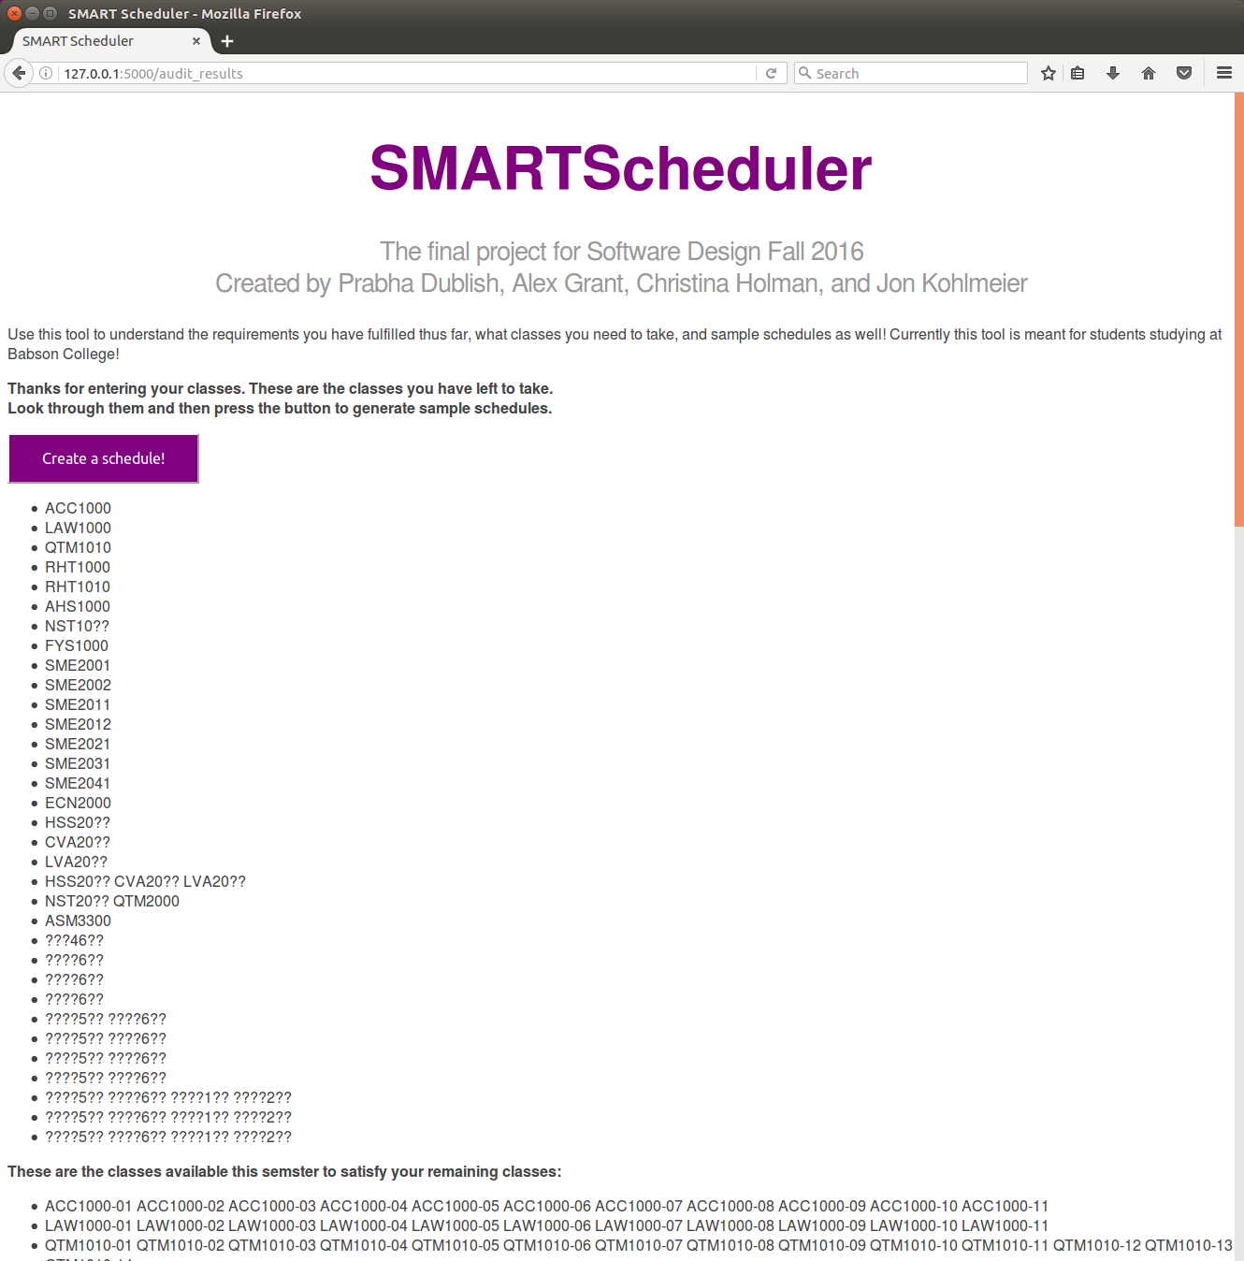
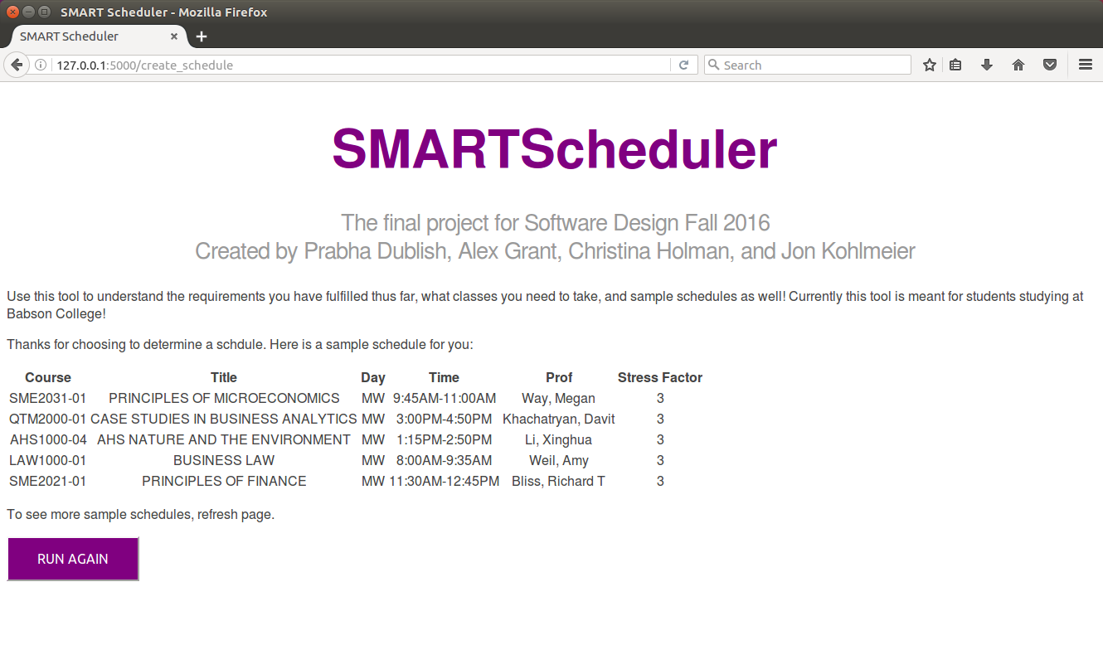
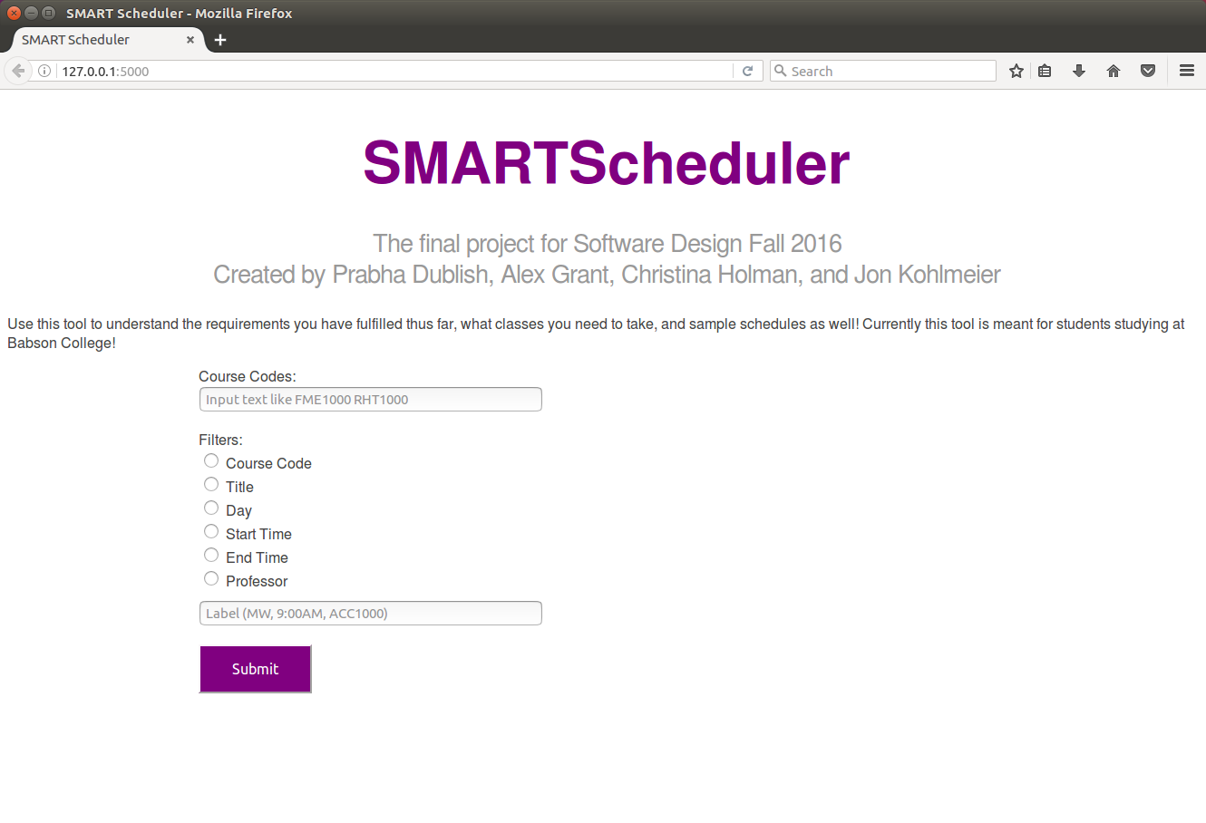


SMARTScheduler
Prabha Dublish, Alex Grant, Christina Holman, Jonathan Kohlmeier
Software Design-ENGR2510-Professor Oliver Steele
The Stress of Course Planning
System Architecture
We've all been through the woes of course planning. Whether it be finding ways to take the classes you like and fulfill the requirements or ensuring your classes don't overlap. Course planning is often more stressful than it needs to be.
Especially as current undergraduate students, we realized that it was hard to determine what classes fulfilled what requirements, and also how do we balance our course load so we aren't taking all hard classes as well.
The classes you have taken
School requirements
Requirements yet to be fulfilled
Classes available in upcoming semester
Possible class options to fulfill your requirements
Your schedule preferences
The Solution: Smart Scheduler
Meet the Smart Scheduler! The go to tool for students looking to determine which graduate requirements they have fulfilled, get a sample schedule, and get insights in terms of class stress levels.
Our tool has three specific functions
Auditing: to determine which graduation requirements you have fulfilled
Scheduling: to create a schedule for the upcoming semester based on what is available and what requirements you have left to fulfill
Stress Level Insights: Understanding which classes are most time consuming based on course evaluation surveys.
** Note this tool is currently built specifically for Babson College students
Schedule that meet graduation requirements and preferences.
For More Information
Project Site: SmartScheduler.weebly.com
GitHub: https://github.com/cholman17/softdesfinalproject
"The key is not to prioritize what's on your schedule, but to schedule your priorities."
--Stephen Covey
Special Thanks To
Olin, Professor Steele, and the all the Ninjas (Serena Chen, Matthew Ruehle, Hannah Twigg-Smith, Sawyer Vaughn)

